Slide 1


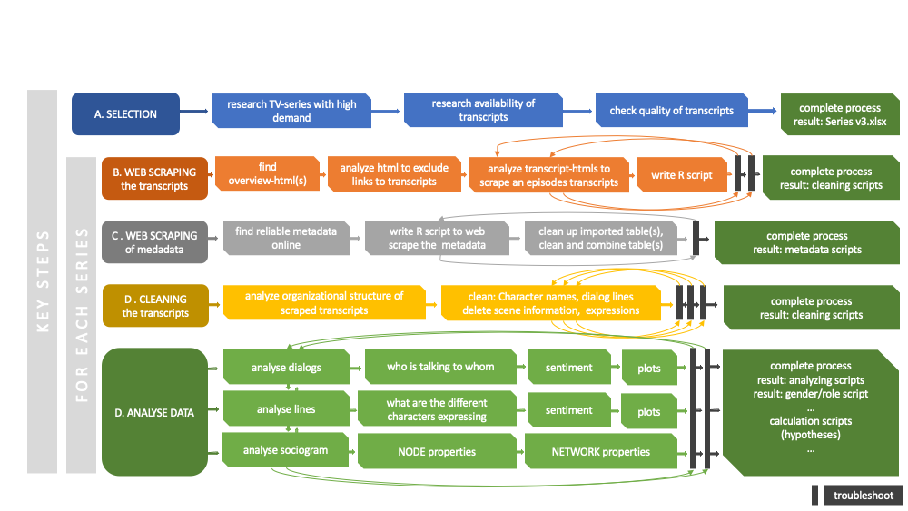

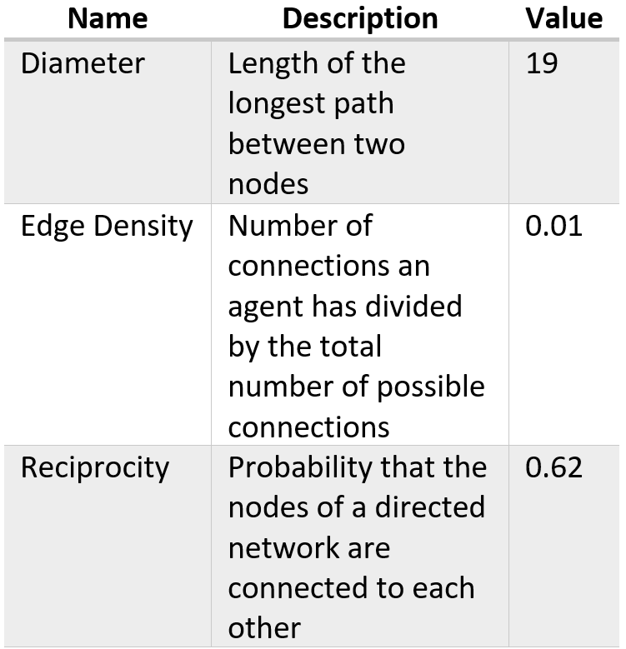
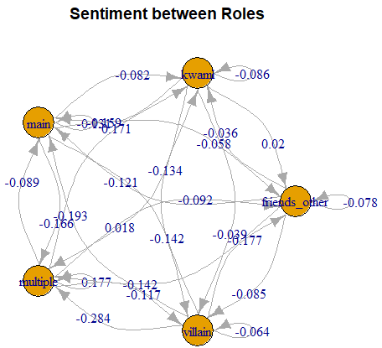
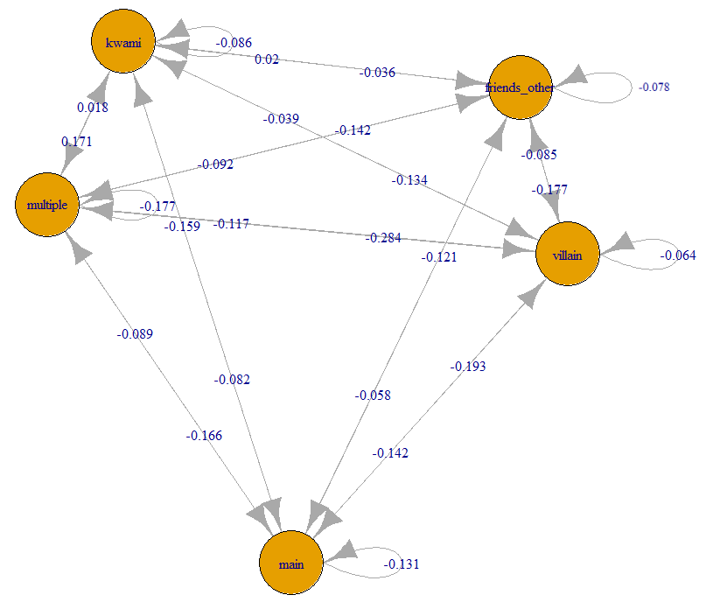
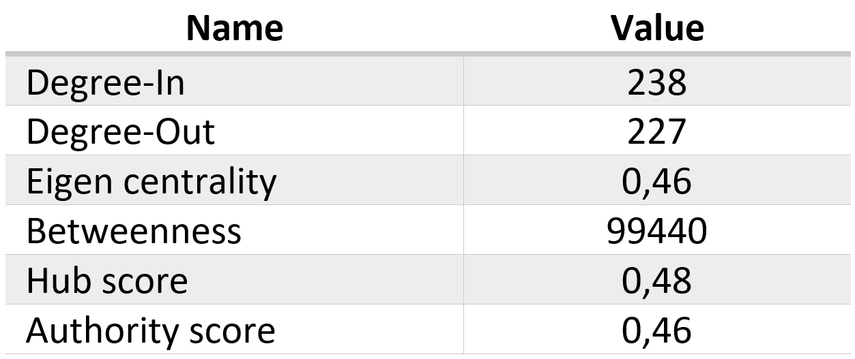
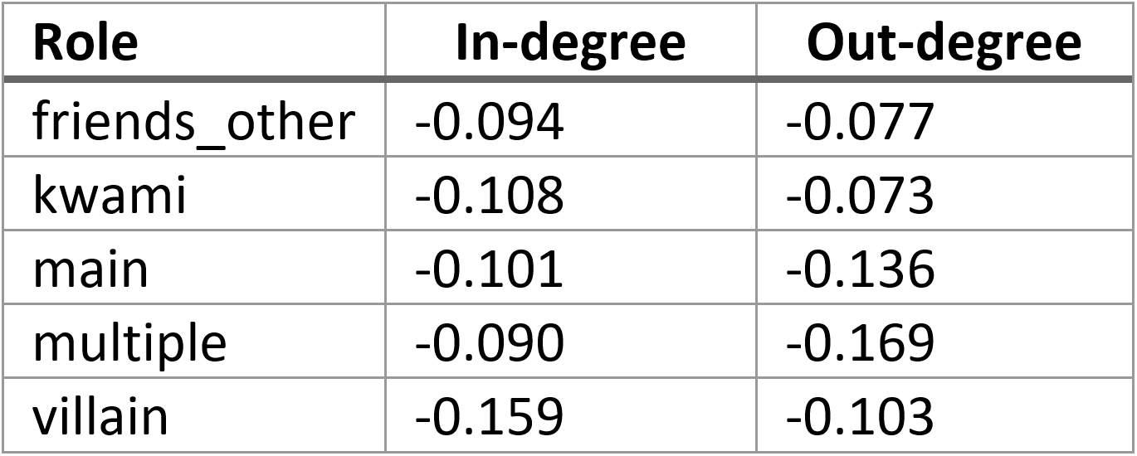


Social structures in children TV series – a network analysis
Laura Gröttrup*, Supervisor: Univ.-Prof. Dr.phil. Guilherme Maia de Oliveira Wood¹
¹University of Graz
Introduction
While in the past the amount of time children could spend watching TV was limited by the number and availability of potential series, nowadays there are hardly any limits, leading to a significant increase of screen time by children [1]. According to social learning theory, children observe role models in their environment and adopt the behavior practiced [2]. Since models can also be fictional characters like TV characters, the interest in how the characters in these series interact with each other grows, as this behavior is imitated by the children [3].
Due to the large amount of data that series bring with them, the goal of this work was to find a computational method to model the social networks in children's series through the verbalization of the characters. Each person in the series takes a role in the system, which is expressed through their behavior towards other characters.
Therefore, the following hypotheses emerged:
H1 | The show has a consistent network structure, which can be measured using different graph measurements
H2 | Average emotional valence is associated to the thematic role of each character
H3 | Heroes show the highest range in the valence of emotions between in- and out-degree
Method
The children's series "Miraculous: Tales of Ladybug & Cat Noir" was chosen. Using R, the fan-made scripts were fetched from the internet. After cleaning, 131 transcripts of episodes with 687 unique speakers (nodes) remained. Metadata such as the assignment of episodes to seasons was also retrieved from Wikipedia using web scrapping and matched with the transcripts.
The communication was defined as always addressing the person speaking next, forming the edges. For the calculation of the sentiment in the verbalizations of the characters the deep-learning R packages sentiment.at was used.
The five characters with the highest betweenness were chosen as main characters, with one person falling into the villain category, which ultimately left four main characters.
Figure 1: Research workflow
Table 1: Graph measurements over the whole serie
Figure 2: Sociogram between roles with sentiment
Results
Edge Density sinnvoll ueber ganze Serie, oder besser pro Folge dann mean?
Through the creation of the graphs, it was possible to identify some characteristics of the social structure within the series. Table 1 shows selected properties of the graph over the complete series, Table 3 shows properties that can be calculated per node, in this case concerning the main character Marinette.
Figure 2 shows the sentiment between the roles. Main character are showing significant more stress when talking to villains as villains when they talking to main. Friends and kwami (like sidekicks) speak with a relatively high valence to everybody except to villains, which is expected for there roles.
In Table 3 one can see the general sentiment score of spoken and received messages. Contrary to what was expected in H3, the main characters do not receive more stress and return less negative statements, but the other way around they receive more positive statements.
Table 2: Node measurements for the main character over the whole serie
Table 3: Mean in- and out-degree of sentiments based on role
References: [1] Chen W, Adler J. (2019). Assessment of Screen Exposure in Young Children, 1997 to 2014. JAMA Pediatr.
2019;173(4):391–393. doi:10.1001/jamapediatrics.2018.5546
[2] Bandura, A. (1969). Social-learning theory of identificatory processes. Handbook of socialization theory andresearch, 213, 262
[3] Meltzoff A. N. (1988). Imitation of televised models by infants. Child development, 59(5), 1221–1229. https://doi.org/10.1111/j.1467-8624.1988.tb01491.x,
*Corresponding author: laura.groettrup@tu-graz.at

